Slide 1

LETTUCEknow Real time address finder
August 19, 2021

Slide 2
Youtube video link
http://youtu.be/omBVXd_2cDk?hd=1

Slide 3
About us
Tech Solution company established in 2020
Mission Statement
With customers we grow
Provide the solutions that will help the community
Always there to provide you the innovative solutions!

Slide 4


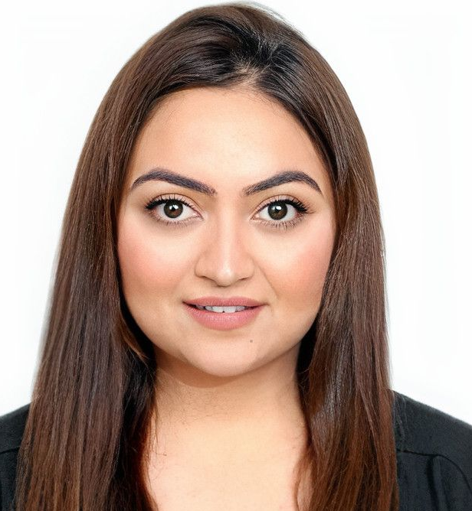
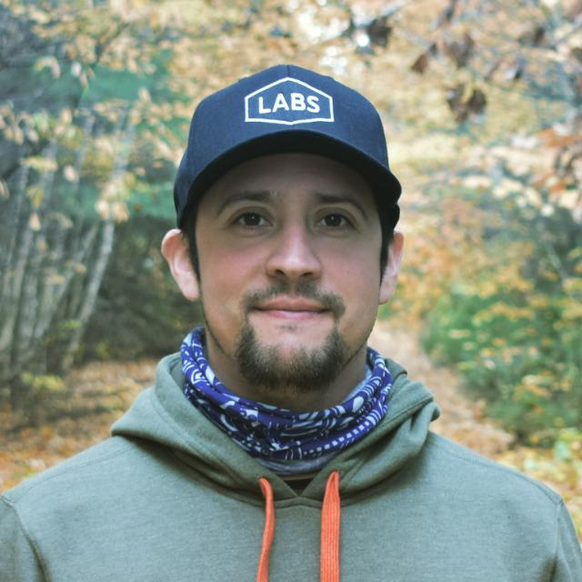

Our team
Project Manager - Kenta Shirakura
Bachelor in Business, 3 years of experience in managing IT project
Business Analyst – Trisha Sharma
Bachelor in Business, 5 years of experience in analyzing businesses of diverse portfolio
Data Analyst - Matias Contreras
Bachelor in Data Science, 4 years of experience providing solutions to our clients
Developer - Pallavi Bhardwaj
Bachelor in Computer Science, 6 years of experience developing web applications

Slide 5
Agenda
Introduction
Project Summary
Technologies involved
The code inside LETTUCEknow
Data acquisition process
Database overview
Front end framework with XXXXx
Demonstration of the web app
Future of this project
Timeline of the implementation

Slide 6
Project Summary
To provide a solution to Roadside Assistant service with more accurate address identification.
The web application created by LETTUCEknow is going to take the IP address of the device that the person is using, and to display the exact address of the app user.
The web application first extracts the data, stores the data in the database, and extracts the data to display visually friendly map.
Thanks to the technology, we will be able to provide a historical information about addresses that the users have been later also.

Slide 7





Technologies Involved
Python It is an open source programming language that is used by a number of people in the world, especially in web applications.
JavaScript and HTML It is a programming language for the web. JavaScript can update and change both HTML which is a standard markup language for documents to display in a web browser.
mongoDB It is an open source database which is one of the most powerful No SQL systems and databases.
Flask It is a web framework written in Python. It does not require any particular tools or libraries. For its simplicity, major companies like Netflix, Reddit and Airbnb use it.

Slide 8


Technologies Involved
Heroku Heroku is a cloud platform that allows build and host an app on a web server.
Git (Gitbash) It is a Unix-based terminal. Heroku manages app deployments with.

Slide 9
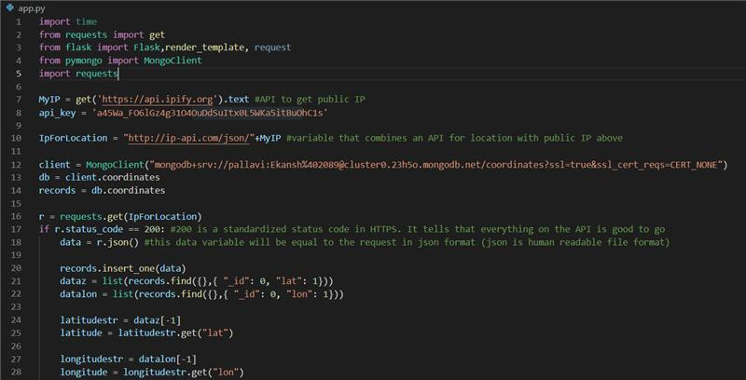
The code inside LETTUCEknow Full code will be shared in the app

Slide 10
The data acquisition
Using the API https://api.ipify.org
The API will get the public IP address of the device that the user is accessing
Sample data acquired

Slide 11

Why is this data important?
The webapp will collect the IP address and other data
The latitude and longitude info(The coordinates) will then be entered to provide the exact address in the map form

Slide 12
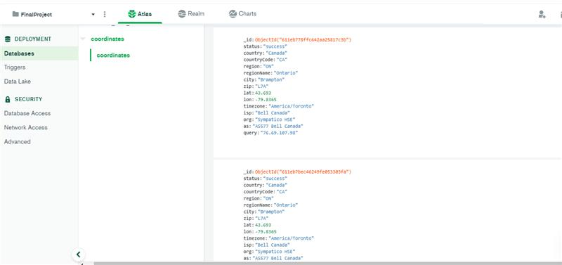
The database

Slide 13
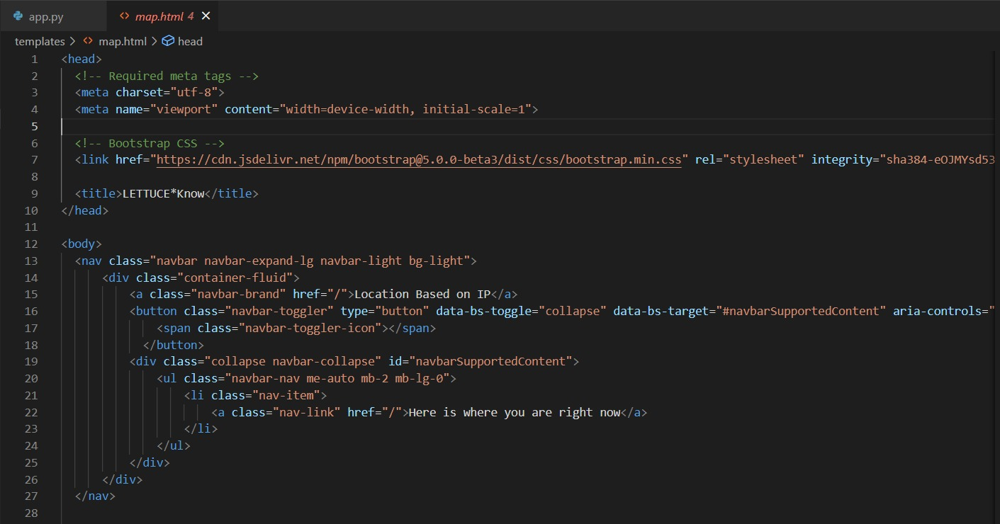
The HTML page

Slide 14
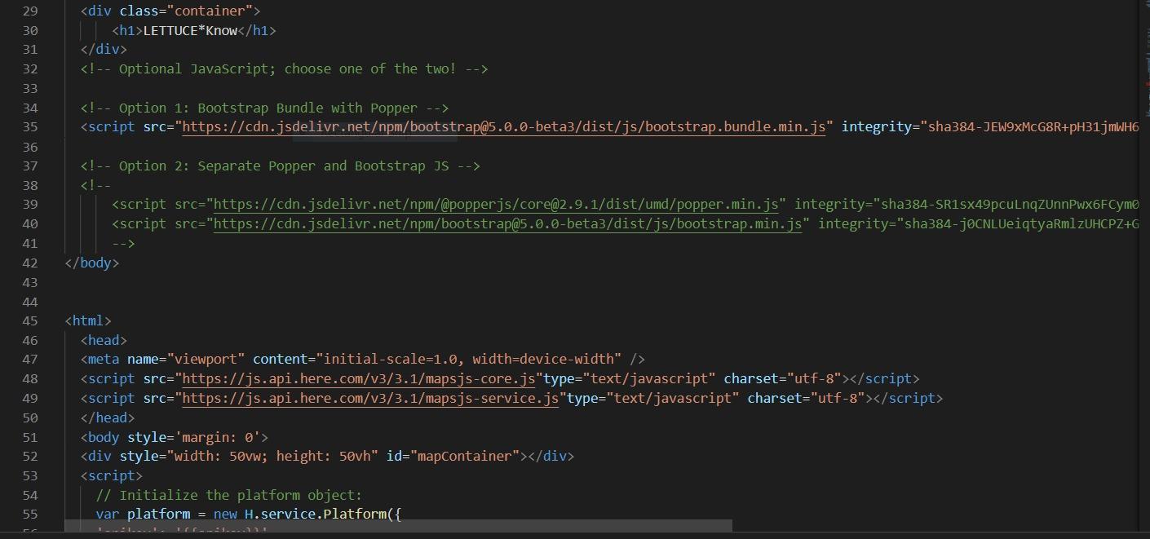
The HTML page

Slide 15
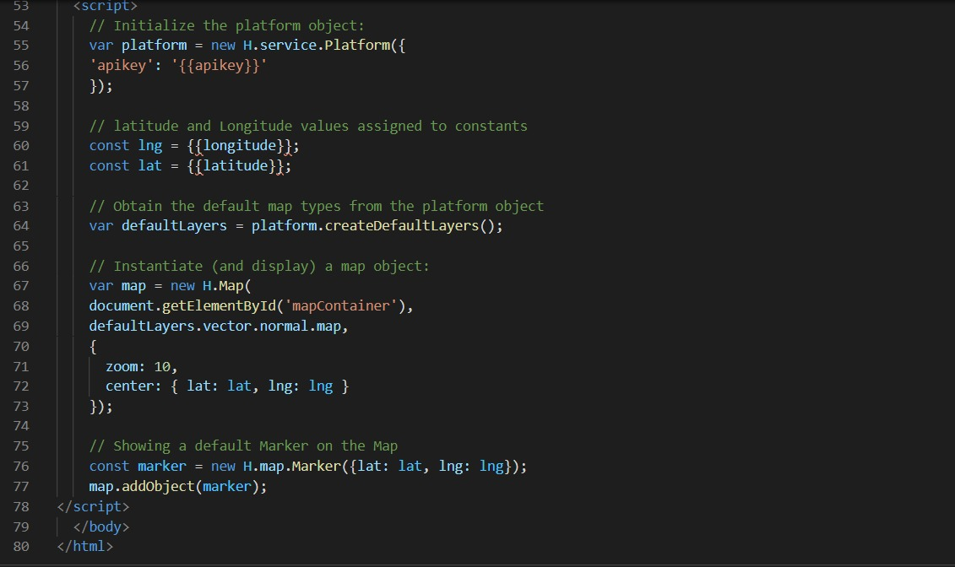
The HTML page

Slide 16
The demonstration of the web app
The URL of the application:
https://lettuceknowbdat.herokuapp.com/

Slide 17
Future of the project
Continue to collect the data
Start analyzing the data, the location and number of reported the Road Side assistance requirement and to be able to visualize the data
Increase the information that the web app can fetch, and to store in the database to be able to provide more robust reporting. Currently the weather information of the public IP location is considered.

Slide 18
Project timeline
Proposal & Finalizing Contract | Analysis | Implementation | Communication & marketing | Further improvement
2 weeks | 8 weeks | 8 weeks | 4 weeks | 12weeks
Presentation of the proposal Negotiate the contract Finalize the contract | Collection of data Audit the data Data analysis | Actual implementation Test phase Deploy the app | Commination to users Public communication to promote your service | Continue to acquire data Analyze the data Test the weather information to increase the data acquisition

Slide 19

Email: info@lettuceknow.com Phone: 1-705-705-7055

